Slide 1
Basic Literary terms
Reading:

Slide 2
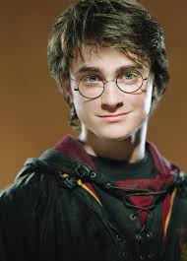
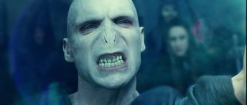
Characterization
PROTAGONIST
Central character
Who/what the story revolves around
Not always a “good person” or “hero”
ANTAGONIST
Protagonist’s opposition
Indicates conflict type (internal or external)
Not always a “bad person” or “villain”

Slide 3
Characterization
DYNAMIC
A character who develops, matures, or changes throughout the story and is considered a complex character
ROUND
A character who/that is richly developed—multiple traits about the character are known and he/she is complex in his/her thinking, actions, etc.
STATIC
A character who remains the same throughout the story in demeanor (doesn’t change)
FLAT
A character who/that is vaguely developed –few traits are known and/or the character is simply depicted with surface-level thoughts, actions, etc.

Slide 4
Point of View Outline
First person:
Told from a character’s point of view
Ex: Narrator uses: I, me, we, our…
Limited and/or biased perspective
Third-person limited:
Told from an outside perspective
Ex: Narrator uses: He, she, they…
Limited
Reader learns about the actions or inner thoughts of only a few characters
Third-person omniscient:
Told from an outside perspective
Ex: Narrator uses: He, she, they…
Knows everything about the characters (Unlimited)
Communicates characters’ thoughts to the reader
May switch back and forth between the different points of view

Slide 5
Point of View Matrix
Categories | Perspective (Who is telling the story?) | Biased (Based on 1 person’s opinions) | Key Words in Narration
1st Person Limited | Character’s (Protagonist) | Yes | I, we, me, our, us, my
3rd Person Limited | Outside | Yes | He, she, they, them
3rd Person Omniscient | Outside | No | He, she, they, them

Slide 6
Setting
Time: When the story takes place
In history: past, present, future
During the day: morning, dusk, night
Time of year: Fall, Spring, Christmas
Place: Where the story takes place
“Well-defined” (Suburban home in Omaha, NE)
“Vague” (Left up to the reader’s imagination- could be just about anywhere)
Link to central conflict: Specific connections between the setting and the main conflict in the story

Slide 7
Series of events in a story. Generally, almost all plots center on at least one conflict, or problem, that the characters struggle to resolve.
Plot
Exposition
Initial Conflict
Rising Action
Climax
Falling Action
Resolution
Problem/Conflict

Slide 8
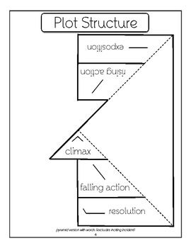
Plot Mountain Foldable!
Cut along the dark lines. Fold the flaps inward along the dotted line.

Slide 9
Exposition
Introduces the setting, the characters, and the conflict
Provides important background information

Slide 10
Exciting Force
The first major event sparks the initial conflict and moves the story into the rising action (marks the end of the exposition)

Slide 11
Rising Action
The conflict is obvious
Complications arise
Suspense begins to build as the main characters struggle to resolve their problem(s)

Slide 12
Climax
The turning point of the story, that point at which the conflict is directly confronted
May occur because of a decision the characters reach or because of a discovery or an event that turns the situation
Usually results in a change in the characters or a solution to the problem

Slide 13
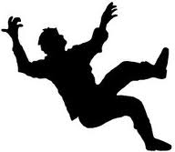
Falling Action
The effects of the climax are shown
The suspense is over
The results of the decision or action that caused the climax are worked out.

Slide 14
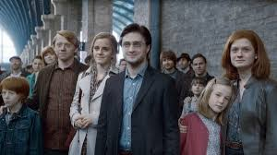
Resolution
Tells how the struggle ends
Ties up any loose ends of the plot
Note that a resolution does not always exist in some contemporary writing/short stories.

Slide 15
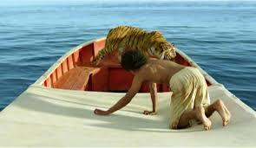
Conflict
A physical or emotional struggle between two forces.
External:
Protagonist vs. Antagonist
Another character
Society
Environment
Deity
Internal:
Protagonist vs. Self
Indecision or nagging
Own worst enemy

Slide 16
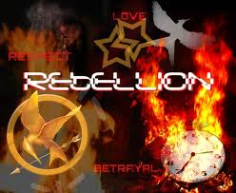
Theme
The message the writer presents through the characters and the plot
Often is about life, or a lesson learned by the characters.

Slide 17
Theme
A theme cannot be stated in a word or two. It can, however, be stated in a sentence or two.
Some stories may have more than one theme.
Start by identifying the main topic of the story, then try to figure out what the author was trying to tell you/teach you about that topic.

Slide 18
Mood vs. Tone
Mood
The feeling or the atmosphere the writer creates for the reader
Similar to genres of movies (i.e. scary/horror, suspenseful, comedic, romantic, adventurous, dramatic)
Tone
The attitude of the author/character toward the subject. It reflects the author’s opinions or the character’s mood
Think of tone of voice (i.e. angry, sarcastic, humorous, light-hearted, serious)

Slide 19
Purpose
The main intent of the piece
Inform
Provides information that is factual with little to no bias
Entertain
Provides information to amuse, shock, and/or engage
Persuade
Provides information to convince, sway, and/or argue a point
Express an Opinion
Provides information to self-express, share, and/or state a belief

Slide 20
Foreshadowing and Flashback
Foreshadowing
A sign of something to come
An indicator of something that suggests beforehand what is to happen
Flashback
A conversation, an episode, or an event that happened before the beginning of the story

Slide 21
Irony
The difference between what appears and what really is.
Verbal Irony: The contrast between what is being said and what is actually meant.
Situational Irony: When things turn out contrary to what is expected or intended.
Dramatic Irony: When the audience knows something the characters do not.

Slide 22
Simile vs. Metaphor
Simile
A comparison between two things using the word “like” or “as”
Metaphor
A comparison between two unlike things that suggests a similarity

Slide 23
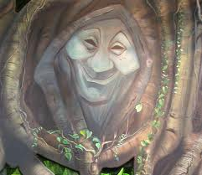
Personification: A phrase that gives human characteristics to inanimate/non-living objects

Slide 24
Hyperbole
An extreme exaggeration (usually using numbers that makes a point. Example: Christina Perri’s “A Thousand Years” Lyrics: “I have died every day waiting for you. Darling, don’t be afraid I have loved you for a thousand years and I will love you for a thousand more.”

Slide 25
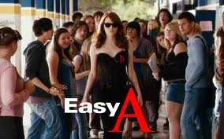
Allusion
A reference to a/an:
Outside literary work
Famous person
Well-known historical event

Slide 26
Onomatopoeia
Words that mimic a sound
Example: CRASH! Bang, ring, buzz

Slide 27
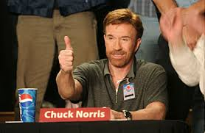
You made it!

Slide 28
The author’s opinion that comes through in a piece, which is often shaped by a number of different factors
Bias
Natural Factors
Age
Gender
Race
Culture
Religion born into
Personal Perspectives
Occupation
Political affiliation
Hobbies
Chosen religion/ Moral standards
Experiences

