Slide 1
Career Center Speeches
What you need to know...

Slide 2
Expectations
3-4 minutes long
Time includes the intro video (30 sec -1 min in length)
Professional & entertaining
Informs the class: - of the education needed (including classes that can be taken here at BWHS) - salary - a typical day - why you’re interested in this career

Slide 3
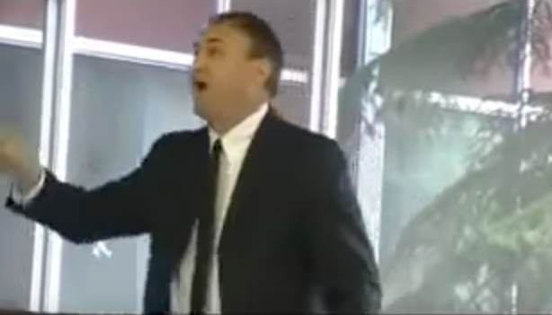
When speaking, don’t...

Slide 4
Do have good posture
Stand up tall
Don’t sway
Don’t fidget
Eye contact!

Slide 5
Use inflection
Sound excited!
Use highs and lows in your voice (Inflection)
Speak slower and faster (Rate)
Speak loudly & clearly (Volume)

Slide 6
More info...
You may use 5 notecards
Speeches in class: Nov 14-16th
Random order
If you don’t go the day you’re called, you automatically lose 20%
PRACTICE AT HOME!

