Slide 1
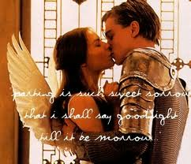
Dramatic Literary Terms

Slide 2
Rhymed Verse
Contains a rhythm, a pattern, and rhymes
Used intermittently when Romeo and Juliet are speaking of their love for one another or when a nobleman is passionate about something.
Ex: Act 1, Scene 5: Romeo says to Juliet, “If I profane with my unworthiest hand This holy shrine, the gentle sin is this: My lips, two blushing pilgrims, read stand To smooth that rough touch with a tender kiss”

Slide 3
Free verse/blank verse
Contains a rhythm or pattern, but does not rhyme
Used by nobility and the educated
Ex: Act 1, Scene 1: Lord Montague tells Benvolio, “Both by myself and many other friends; But he, his own affections’ counselor, Is to himself– I will not say how true— But to himself so secret and so close.”

Slide 4
Prose
Written like ordinary language (no rhythm or rhyme)
Used by nobility when losing their minds and/or by commoners and servants
Ex: Act 1, Scene 1: Sampson tells Abram, “Nay, as they dare. I will bite my thumb at them, which is disgrace to them, if they bear it.”

Slide 5
Monologue
A long speech made by one character to other characters (and the audience)
Ex: Act 1, Scene 4: Mercutio (1:00 in) “O, then I see Queen Mab hath been with you. She is the fairies’ midwife, and she comes In shape no bigger than an agate stone On the forefinger of an alderman…”

Slide 6
Soliloquy
A long speech made by one character to him/herself (and the audience)
Ex: Act 2, Scene 2: Romeo spying on Juliet from below…

Slide 7
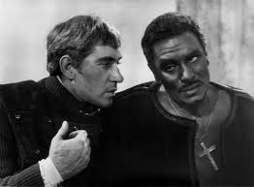
Aside
A remark whispered by one character to another character, which other characters are not supposed to hear.
Ex: Act 1, Scene 1: Sampson’s “Is the law of our side if I say ay?” (to Gregory)

Slide 8
Personification
Giving human qualities to an object, animal, or idea
Ex: Act 2, Scene 3: Friar Laurence speaks of nature and says, “The grey-eyed morn smiles on the frowning night…”

Slide 9
Pun
A play on words
Ex: Act 3, Scene 1: Mercutio says, “Ask for me tomorrow and you shall find me a grave man.”
Lion King Pun

Slide 10
Allusion
A reference to something outside of the text, usually another literary work.
Ex: Act 2, Scene 4: Mercutio describes Tybalt as, “More than Prince of Cats. O, he’s the courageous captain of compliments.” An allusion to the medieval fable, Reynard the Fox, and its charcter of Tybert who is this prince of cats.

Slide 11
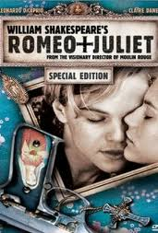
Foil
A character who provides a striking contrast to another character
Ex: Act 1: Love-sick/romantic Romeo and fiery Tybalt

Slide 12
Juxtaposition
A scene that provides a striking contrast to another scene.
Ex: Act 2, Scene 1: Mercutio’s dirty-mouthed views of love and Act 2, Scene 2: “The Balcony Scene” in which Romeo and Juliet express their pure love for one another.

Slide 13
Dramatic Irony
When the audience knows something that the characters do not.
Ex: Romeo does not want to fight Tybalt because he has married Juliet. (Romeo knows, the audience knows, but the other characters in the scene do not.)
Example #2

Slide 14
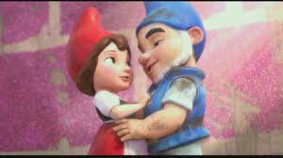
Metaphor
A comparison between two unlike objects that suggests a similarity
Ex: Act 2, Scene 2: Romeo declares, “It is the east, and Juliet is the sun!”

Slide 15
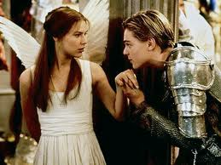
Hyperbole
An exaggeration for the sake of emphasis
Ex: Act 2, Scene 2: Juliet tells Romeo, “A thousand times goodnight!”

Slide 16
Simile
A comparison between two things using “like” or “as”
Ex: Act 2, Scene 2: Juliet tells Romeo, “I have not joy of this contract tonight…too like the lightning, which doth cease to be.”

Slide 17
Iambic Pentameter
A popular metrical line (rhythm)
Measured in pairs of syllables called “feet”
First syllable is unstressed followed by a stressed syllable
Pentameter = 5 “feet”
Heartbeat; “Trapeze”

Slide 18
Sonnet
14 lines long
Follows a rhyme scheme: a-b-a-b, c-d-c-d. e-f-e-f, g-g
The last two lines are a rhyming couplet

Slide 19
Sonnet 116
Let me not to the marriage of true minds Admit impediments, love is not love Which alters when it alteration finds, Or bends with the remover to remove. O no, it is an ever-fixed mark That looks on tempest and is never shaken; It is the star to every wand’ring bark, Whose worth’s unknown, although his height be taken. Love’s not Time’s fool, though rosy lips and cheeks Within his bending sickle’s compass come, Love alters not with his brief hours and weeks, But it bears it out even to the edge of doom: If this be error and upon me proved, I never writ, nor no man ever loved.

