Slide 1
Elements of the {Epic} Hero Cycle
English 9/9A

Slide 2
{Supernatural} HERO ¹
Element #1
Harry Potter
The main character is a hero, who often possesses supernatural abilities or qualities.

Slide 3
On a {mission} ²
The hero is charged with a quest.

Slide 4
{Tried} and True ³
The hero is tested, often to prove the worthiness of himself and his quest.

Slide 5
{more than} human ⁴
The presence of numerous mythical beings, magical and helpful animals, and human helpers and companions.

Slide 6
{far, far away} lands ⁵
The hero’s travels take him to a supernatural world, often one that normal human beings are barred from entering.

Slide 7
Don’t {give up} yet! ⁶
The epic hero cycle must reach a low point where the hero nearly gives up his quest or appears defeated.

Slide 8
{arise} ⁷
Resurrection

Slide 9
Winner, Winner ⁸
Restitution. Often this takes the form of the hero regaining his rightful place on the throne.

Slide 10
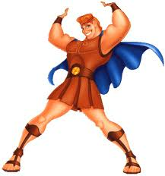
Characteristics of an Epic {Hero}

Slide 11
{Larger} than life ¹
A larger-than-life hero who embodies the values of a particular society.

Slide 12
Ford {tough} ²
Superhuman; stronger, smarter, and more clever than an ordinary person.

Slide 13
{Journey} ³
The epic hero is on a quest for something of great value to himself or his people.

Slide 14
Mixed {heritage}
The epic hero often comes from mixed heritage: both human and divine parents; he will have human weaknesses.

Slide 15
Interference ⁵
The divine world (the gods) interfere with the human realm.

