Slide 1
Understanding and Using: Logos, Ethos & Pathos
Intro to Research and Persuasion Unit

Slide 2
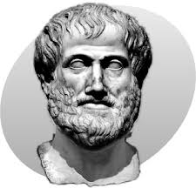
Aristotle (philosopher) taught that one’s ability to persuade an audience is based on how well the speaker appeals to that audience in three different areas: logos, ethos, and pathos.

Slide 3
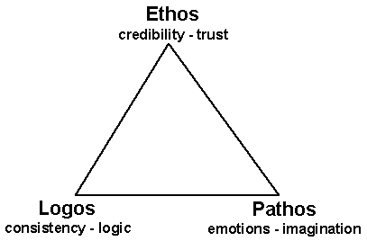
Balance
These three areas should be balanced within a text.
Logos
Ethos
Pathos

Slide 4
LOGOS (most important)
Appeals to reason
Main point is clear (strong thesis)
Well supported with facts and examples

Slide 5
ETHOS
Appeals to the writer’s character or credibility
When reading, we may ask ourselves: “What does this author know about this topic?” “Why should I trust this person?”
Naturally persuaded by a person who we think: - is intelligent or well educated - is friendly or warm - is considerate of others

Slide 6
PATHOS
Appeals to the emotions, beliefs and values of the reader

Slide 7
Advertisements….
Examples of Ethos, Logos, and Pathos in Advertising

Slide 8
Your turn!
Find ONE example for EACH: pathos, logos, ethos.
Explain in ONE SENTENCE how that ad is an example of pathos, logos, or ethos.

