Slide 1
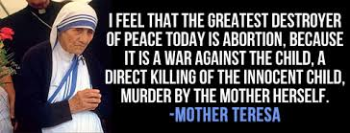
Notes:
Introduction Slide: This quote = attention getter

Slide 2
Our own Declaration of Independence guarantees us the right to:
Notes:
1st Main point: The Declaration of Independence guarantees EVERYONE to the right to LIFE. Without LIFE, what other right matters?

Slide 3
Notes:
2nd Main Point: Life begins at conception, not 12 weeks, not 28 weeks, not birth.

Slide 4
Notes:
3rd Main Point: It is not a woman’s right to kill her child because the baby is not apart of her. It has it’s own separate DNA.

Slide 5
Notes:
1st counter-argument: “Women will die in botched abortions if the procedure is made illegal.”

Slide 6
Notes:
2nd Counter-argument: “What about in cases of rape?” If you click the picture, it will open up a 1:30 video I would show in my presentation at this point.

Slide 7
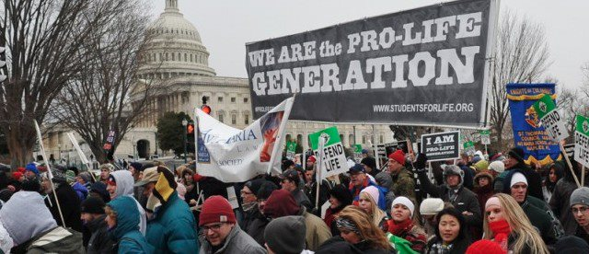
Notes:
What can we do? Volunteer at Crisis Pregnancy Centers, Donate supplies, Offer advice and free babysitting services to a struggling mother we know, pray at abortion clinics, educate ourselves, write to legislators, Walk for Life in Washington DC or in Lincoln, Ne (Both in January).

Slide 8
Notes:
Conclusion: Choose life.

