Slide 1
Tale of Two Cities
English 9A January 2014

Slide 2
Some Details
Five week unit… lots of reading!
Focus on Reading Strategies & his writing style
Beneficial if AP classes are in your future (which they should be!)
Expect reading homework every night… (sorry!)

Slide 4
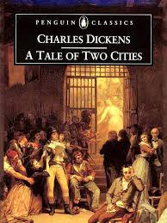

Slide 5
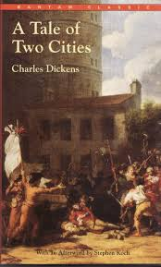

Slide 9
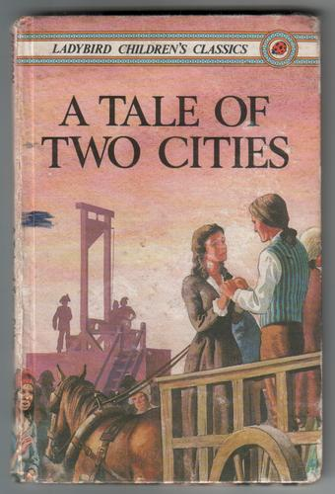

Slide 10
Possibilities…
Topics
Tone/Mood
Violence/War
Revolution
Love
Depressing
Ominous
Empowering

Slide 11
Charles Dickens

Slide 12
Charles Dickens
Catherine and Charles have 10 children
Eventually, he is overwhelmed and blames Catherine for the kids and the expenses; he becomes disillusioned
He visits America and finds it “crass”

Slide 13
Tale of Two Cities
“It was the best of times, it was the worst of times.”
Differs from his other works, focuses on plot
Social critique of England and France right before and during the French revolution

Slide 14
French Revolution
1789-1790
Period of radical social and political upheaval
Monarchy was overthrown in three years

Slide 15
What started it all?
Age of Enlightenment was an underlying stir
Enlightenment = question authority, explore, [[reason, science, philosophy & knowledge]], think for yourself
Lower and middle classes started to question the social structure asking, “Why are the aristocrats privileged?”
Financial problems = 7 years war
No plague (led to a high population)

Slide 16
What started it all?
Mismanagement of funds = Louis taxed the poor and not the rich
Marie Antoinette spent lots of money leading their country into a deficit (debt)

Slide 17
Time Line
1788 = flour shortage; one month salary would buy one loaf of bread
The finance minister recommends calling of Estates General to get cash to help their budget
Unequal representation (clergy, nobles, bourgeoisie (97%))
July 14, 1789 = Bastille Day; storm the Bastille (largest prison); steal gunpowder, put the Warden’s head on a pike; beginning of popular violence

Slide 18
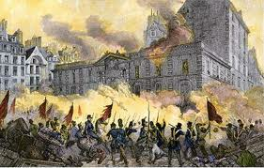
French Revolution
June 10, 1792 = end of the monarchy
January 21, 1793 = Louis beheaded
October 16, 1793 = Marie Antoinette beheaded

