Slide 1
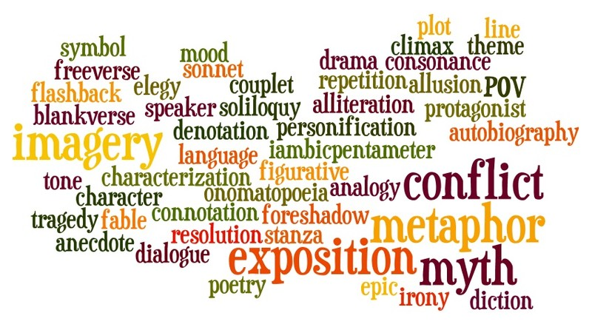
Literary Terms
English 9 & 9A

Slide 2
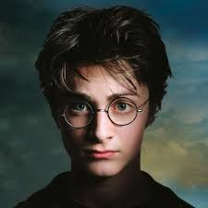
Types of Main Characters
Protagonist
Central character
Antagonist
Protagonist’s opposition

Slide 3
Types of Characters
Dynamic
A character who develops or changes throughout the story and is considered a complex character.
Round
A character that is richly developed throughout the story and is complex in his/her thinking, actions, etc.
Flat
A character that is barely developed, few traits are known and the character is simply depicted with surface-level thoughts, actions, etc.

Slide 4
Setting
Time: When the story happens
In history (past, present, future)
During the day (morning, dusk, night)
Time of Year (Fall, Spring, Christmas)
Place: Where the story happens
“Well-defined” (Bellevue, NE)
“Vague” (left up to the reader’s imagination--- could be just about anywhere)

Slide 5
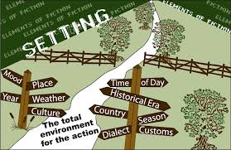
Setting
Link to central conflict: Specific connections between the setting and the main conflict
Think: Why did the author choose this setting? How does it advance the story? Complicate it?

Slide 6
Plot
Basic Plot Structure: Exposition (Exciting Force), Rising Action, Climax, Falling Action, Resolution
All of this centers on at least one conflict that the characters struggle to resolve.
Climax
Rising Action
Falling Action
Resolution
Exposition
(Exciting Force)

Slide 7
Exposition
Introduces the setting, characters, and the conflict
Provides necessary background information

Slide 8
Exciting Force
The first major event that sparks action and moves the story forward
Marks the beginning of the rising action

Slide 9
Rising Action
The conflict is obvious
Complications arise
Suspense builds

Slide 10
Climax
The conflict is directly confronted

Slide 11
Falling Action
Effects of the climax are shown

Slide 12
Resolution
Tells how the story ends
Ties up loose ends
Short stories may not have a resolution

Slide 13
Theme
The message the writer presents through the plot and the characters
The theme is often about life or a lesson learned by the characters

Slide 14
Theme

Slide 15
Themes
Can you think of some movies or books with these common themes?
Growing up
Friendship
Determination
Courage
Notes:
1) Sandlot, The Lion King, 2) Now & Then 3) All Sports movies 4) Milk, Hunger Games, War movies

Slide 16
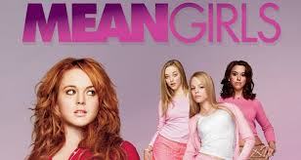
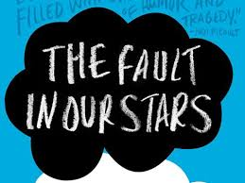
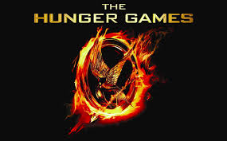
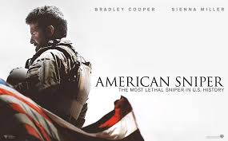
Themes
Growing up:
Determination:
Friendship:
Courage:

Slide 17
Mood vs. Tone
Mood: The emotions of the reader
Tone: The attitude of the author toward the subject. It usually reflects the author’s opinion or the character’s mood.

Slide 18
Purpose
Purpose: The main intent of the piece. 1) Inform 2) Persuade 3) Entertain 4) Express an Opinion
Newspaper
Advertisement
Fiction Book
Blog Post

Slide 19
Literary Terms
Foreshadowing: a sign of something to come

Slide 20
Literary Terms
Allusion: A reference to an outside literary work, famous person or well-known historical event.
“Shut Up And Dance” by Walk the Moon: “A backless dress and some beat up sneaks, My discotheque, Juliet teenage dream. I felt it in my chest as she looked at me. I knew we were bound to be together, Bound to be together.”

Slide 21
Literary Terms
The contrast between what appears and what really is
Verbal Irony: The contrast between what is being said and what is actually meant.
Situational Irony: When things turn out opposite to what is expected.
Dramatic Irony: When the audience knows something the characters do not.

Slide 22
Literary Terms
Simile: A comparison between two things using like or as
Metaphor: A comparison between two unlike things that doesn’t use like or as

Slide 23
Literary Terms
Personification: A phrase that gives human characteristics to inanimate/non-living objects.

Slide 24
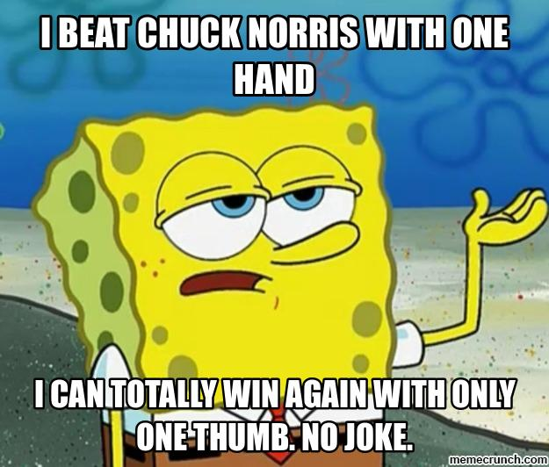
Literary Terms
Hyperbole: An extreme exaggeration used to add emphasis

Slide 25
The End!
My tips to you: 1) Review these notes 2) Use the Quizlet flashcards on the class website
Muldoonenglish.weebly.com
You made it!

