Slide 1
The Odyssey
Background Information Muldoon 2016

Slide 2
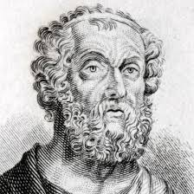
Homer
Lived around 700-800 B.C.
Wrote The Iliad and The Odyssey
Blind
No one actually knows if he really existed

Slide 3
Trojan War
This video explains it all.
And this shows The Trojan Horse from the movie Troy

Slide 4
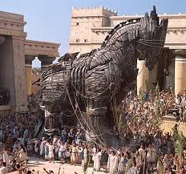
Trojan Horse

Slide 5
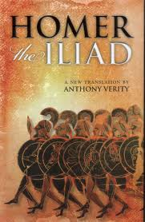
The Iliad
Written before The Odyssey
About the last few weeks of the Trojan War
Where we first meet Odysseus as a character

Slide 6
The Odyssey
About Odysseus’ 10 year journey back from the Trojan War
24 books long (We only read 6!)
Originally passed through oral tradition It would take over a day to share!
Often the “entertainment” of social gatherings

Slide 7
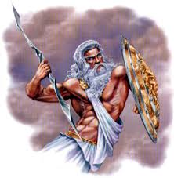
Zeus
Lives on Mt. Olympus
Ruler of the gods
Brother to Poseidon…
Has many affairs

Slide 8
Athena
Goddess of war and wisdom
Daughter of Zeus
Poseidon is her enemy (Both tried to give gifts to Greece… olive tree/water spout.)

Slide 9
Poseidon
God of the sea and earthquakes
Brother to Zeus…
Athena is his enemy
Father of Polyphemus, the cyclops

Slide 10
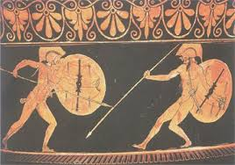
Kleos
“Reputation”
Honor
Implies what others “hear about you”
Gain more “kleos” (or honor) through battle

Slide 11
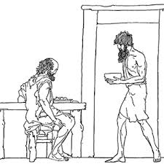
Xenia
“Guest friendship”
Greek tradition of treating guests with hospitality (kindness)

Slide 12
Epithet
Repetitive adjective or phrase that describes a character or object
Often used to remind the speaker of where they are in the story
“Rosy-fingered dawn” and “master mariner”

Slide 13
Characteristics of an EPIC
Long, narrative poem
About the journey of a hero
Reflects the nation’s ideals and values
Mostly legend– LOTS of imagination used behind a small nugget of truth

Slide 14
Epic Simile
Comparing two using like or as
Multiple lines long
Used to add emphasis

Slide 15
Allusion
A reference to another literary work, historical event, famous person

Slide 16
Plundered
Verb
To rob by force

Slide 17
Insidious
Adjective
Deceitful
Appears nice, but is actually mean

Slide 18
Dispatched
Verb
Finished quickly
To send away quickly

Slide 19
Equity
Noun
Fairness,
Justice

Slide 20
Contempt
Noun
Disdain, disgust
The feeling that something is below you; unworthy

Slide 21
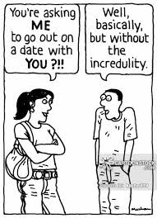
Incredulity
Noun
Inability to believe

Slide 22
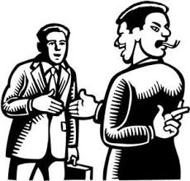
Dissemble
Verb
To conceal under a false appearance
To hide one’s real intentions

Slide 23
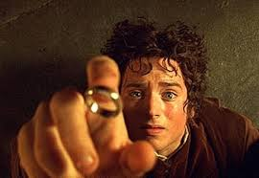
Characteristics of an EPIC HERO
Larger-than-life
Usually male
Embodies the ideals of a nation
Often changes the fate of a nation or group of people

Slide 24
Hera
Goddess of marriage and fertility
Wife of Zeus
Siblings

Slide 25
Apollo
God of light/sun, music, and prophecy
Zeus is his dad
Invented the lute
http://www.youtube.com/watch?v=7goe9JYZJS8

Slide 26
Hephaestus
Crippled
Son of Zeus and Hera
God of metal, fire
Kind, but ugly
Created Achilles’ armor during the Trojan War

Slide 27
Helios
Sun god

Slide 28
Hermes
Messenger to the gods
Golden winged sandals

