Slide 1
High School English Teacher
Created by: Mrs. Muldoon

Slide 2
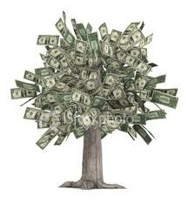
H
uman services = career cluster
S
tarting salary is $28,000 - $40,000
T
eaching students reading, writing, and grammar

Slide 3
E
xpected growth rate of 7%
A
verage median salary: $50,000
C
orrect papers, enter grades, design assignments

Slide 4
H
elp struggling students with different strategies
E
ducation needed: Bachelor’s degree, endorsement, teaching certificate
R
esponds to parents and administration

Slide 5
Because…
Invest in Others
Knowledge is Power
Great Hours and Schedule

