Slide 1
Sentence Fluency
English 9/9A Muldoon

Slide 2
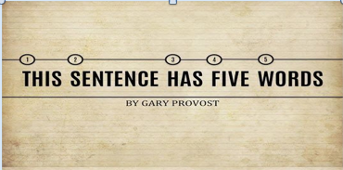
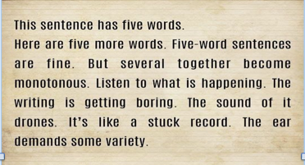

Slide 3
Examples…
Include a “boring” example from Speak where it’s kind of monotonous…

Slide 4
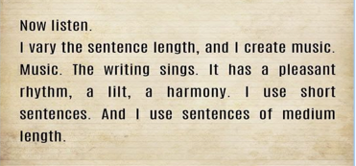
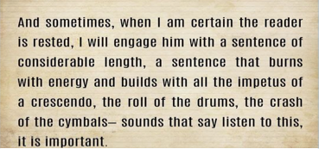

Slide 5
Example
Include an example from Speak that has a good, long sentence? … if there is one…

Slide 6
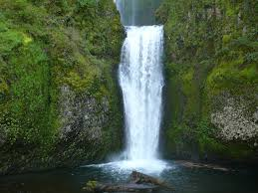
What is sentence fluency?
The rhythm or flow of the writing; how it sounds to the ear
Sentences of varying length and structure
Natural phrasing

Slide 7
Strong Sentence Fluency…
Makes your writing more interesting & memorable
Adds style and voice to your writing

Slide 8
How do I write with strong sentence fluency?
Vary your sentence lengths
Vary your sentence structures Here are 6 types of sentences to try….

Slide 9
Two adjective beginnings
Tall, handsome lifeguards flirt with the pretty girls.
Rickety and dilapidated, the old schoolhouse didn’t stand a change in an earthquake.

Slide 10
Start with a prepositional phrase
Under the stars, the couple shared their first kiss.
In my room, I spent hours memorizing and perfecting my speech.

Slide 11
Using “-LY” beginnings
Cheerfully, she answered the phone for her mother.
Slowly opening the door, I tried to sneak out without my parents hearing.

Slide 12
Using “-ING” beginnings
Running like the wind, I turned the last corner and sprinted to the finish line.
Saving the best for last, Lisa finally ate her Reese’s peanut butter cup.

Slide 13
Using “-ING” before endings
He trudged along the hot desert for days, wishing he had brought more water.
I gave the homeless man all the money I had, hoping that this small act of kindness might bring him some comfort.

Slide 14
Appositives (a phrase set apart by commas; the sentence would still make sense without this phrase)
The fish, a slimy mass of flesh, felt the alligator’s giant teeth sink into him as he struggled to swim away.
The child, face covered with chocolate doughnut, asked his mother if he could have some milk.

Slide 15
Lists
Choosing a Christmas tree, putting up Christmas lights, and baking Christmas cookies are all included in my December traditions.
I should’ve known better than to trust my ex-boyfriend, lie to my friend, and skip volleyball practice.

Slide 16
Dependent Clauses (phrases that cannot stand alone as a complete sentence)
Because of rain, the Homecoming Dance was moved indoors.
Since I stayed up late watching How I Met Your Mother on Netflix, I fell asleep in class today.

Slide 17
Don’t start sentences with “THIS”
Instead of: Melinda had low self-esteem. This caused her to have trouble making friends. (2 short, simple sentences.)
Combine them using WHICH (to create 1 sentence): Melinda had low self-esteem which caused her to have trouble making friends.

Slide 18
Don’t start sentences with “IT”
Try to rewrite the sentence to remove “IT.”
Sometimes this can be done by combining 2 sentences together.
Instead of: Melinda’s tree went through many stages. It was a doodle, a painting, and a sculpture.
Try combing the sentences together: Melinda’s tree went through many stages including a doodle, a painting, and a sculpture.

